Slide 1

CS302 Design and Analysis of Algorithms
Muhammad sohail afzal

Slide 2
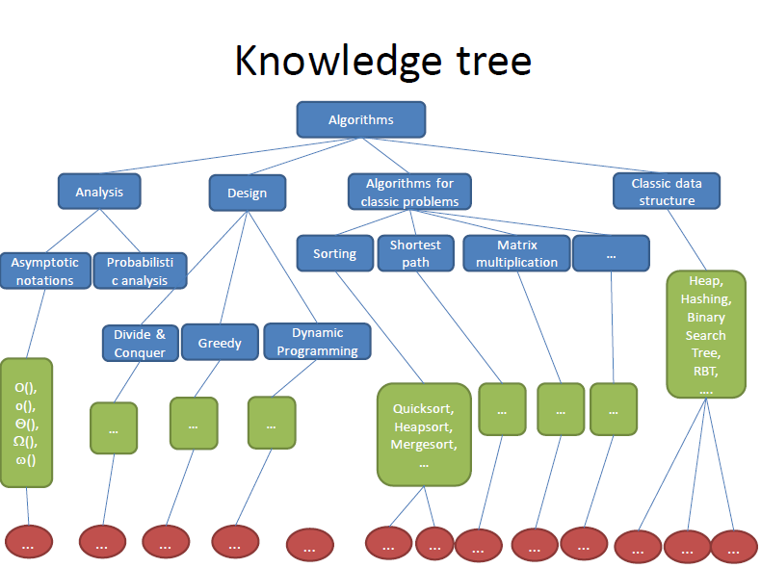
Hierarchy

Slide 3
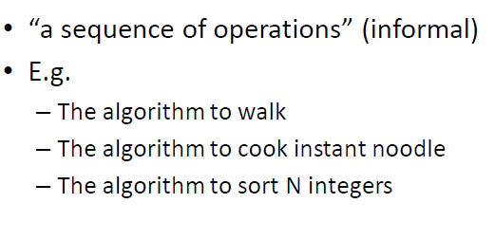
What are Algorithms !
Informally, an algorithm is any well-defined computational procedure that takes
some value, or set of values, as input and produces some value, or set of values, as
output. An algorithm is thus a sequence of computational steps that transform the
input into the output.

Slide 4
Algorithms
An algorithm is said to be correct if for every input it halts (terminates/stops) with the correct output.
An incorrect algorithm might not halt (terminate/stop) at all on some input instances, or it
might halt with an incorrect answer
An algorithm can be specified in English, or as a computer program or as a hardware design.

Slide 5

Examples of Algorithms - Sorting
You want to design algorithm that sort numbers in ascending order :
Formally you can define it as :

Slide 6
Examples of Algorithms - Sorting
For example, given the input sequence (31, 41, 59, 26, 41, 58), a sorting algorithm
returns as output the sequence (26, 31, 41, 41, 58, 59). Such an input sequence is
called an instance of the sorting problem. In general, an instance of a problem
consists of the input needed to compute a solution to the problem.

Slide 7
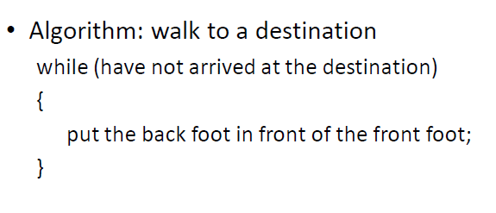
Examples of Algorithms - Walk

Slide 8
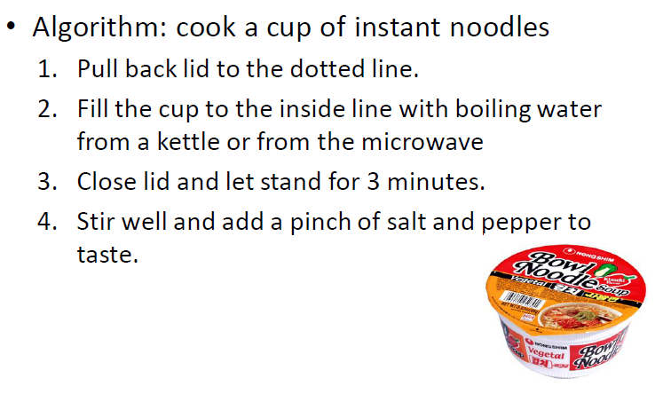
Examples of Algorithms – Cook Noodles

Slide 9

Applications of Algorithms – HGP
The Human Genome Project has made great progress toward the goals of identifying all the 100,000 genes in human DNA, determining the sequences of the 3 billion chemical base pairs that make up human DNA, storing this information in databases, and developing tools for data analysis. Each of these steps requires sophisticated algorithms

Slide 10
Applications of Algorithms - Internet
The Internet enables people all around the world to quickly access and retrieve large amount of information. With the aid of clever algorithms, sites are managing this large volume of data
Also Algorithms are used for finding good routes on which this data will travel
Algorithms for using a search engine to quickly find pages on which particular information resides

Slide 11
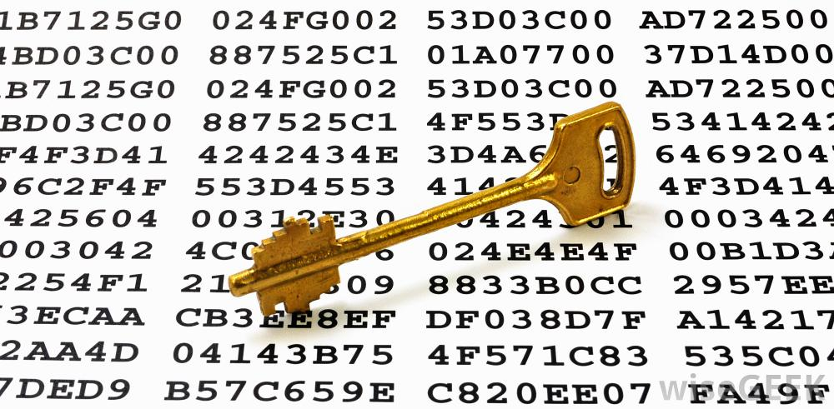
Applications of Algorithms - Security
Electronic commerce enables goods and services to be negotiated and exchanged electronically, and it depends on the privacy of personal information such as credit card numbers, passwords, and bank statements. The core technologies used in electronic commerce include public-key cryptography and digital signatures (covered in Chapter 31), which are based on numerical algorithms and number theory.

Slide 12
Applications of Algorithms - Others
An oil company may wish to know where to place its wells in order to maximize its expected profit
A political candidate may want to determine where to spend money buying campaign advertising in order to maximize the chances of winning an election
An airline may wish to assign crews to flights in the least expensive way possible, making sure that each flight is covered and that government regulations regarding crew scheduling are met

Slide 13
Algorithm – Practical Problem
A transportation firm, such as a trucking or railroad company, has a financial interest in finding shortest paths through a road or rail network because taking shorter paths results in lower labor and fuel costs. Or a routing node on the Internet may need to find the shortest path through the network in order to route a message quickly.
There are lot many examples like this.
Many candidate solutions, the overwhelming majority of which do not solve the problem at hand. Finding one that does, or one that is “best,” can present quite a challenge.

Slide 14
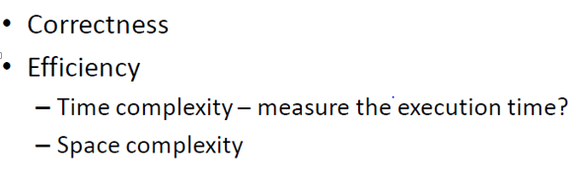
Algorithm Performance Measures
Where time complexity depends on number of key operations required and space complexity depends on number of space units needed

Slide 15
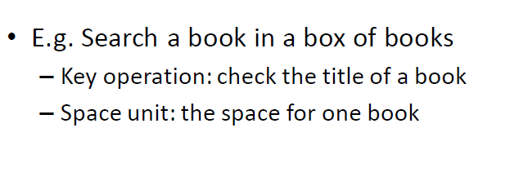
Algorithm Performance Measures

